Slide 1
Web Application
Using Django
Part IV

Slide 2
Forms
Web apps are built for two-way interaction. A static web page is not very useful unless it is for informational purposes only.
Forms allow us to receive input from any user across the world and process it
We will create forms that will allow users to create their own topics and entries
Forms can be dangerous, therefore we need security and authentication
Forms work similar to pages – define a URL, view and template

Slide 3
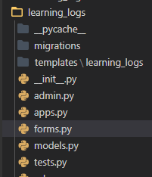
Forms
Validate user information (malicious code)
Save the information in the appropriate place in the database
Automated in Django
Simplest way to build a form is to use ModelForm which uses the models already in your project (Topic, Entry) to build a form
create a new file named forms.py in the learning_logs directory (app). Should be in the same location as models.py file
Notes:
ModelForm uses the models already built in your project (Pizza, Topping) to build a form.

Slide 4
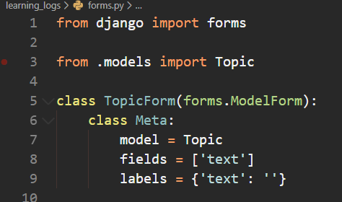
Adding New Topics
define a class called TopicForm, which inherits from forms.ModelForm
The simplest version of a ModelForm consists of a nested Meta class telling Django which model to base the form on and which fields to include in the form

Slide 5

The new_topic URL

Slide 6
The new_topic() View Function
The new_topic() function needs to handle two different situations:
initial requests (blank form)
processing any data submitted on the form
The two main types of request you’ll use when building web apps are GET requests and POST requests.
GET requests for pages only read data from the server
POST requests writes data through a form to the server

Slide 7

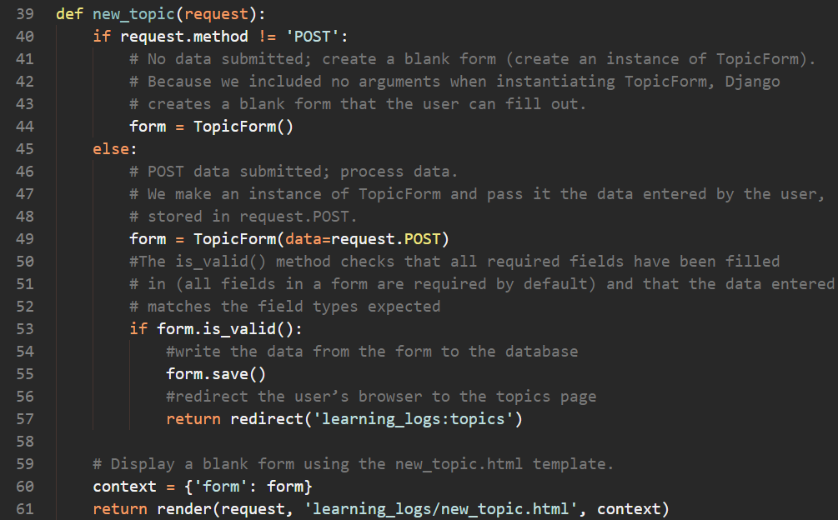
The new_topic() View Function

Slide 8
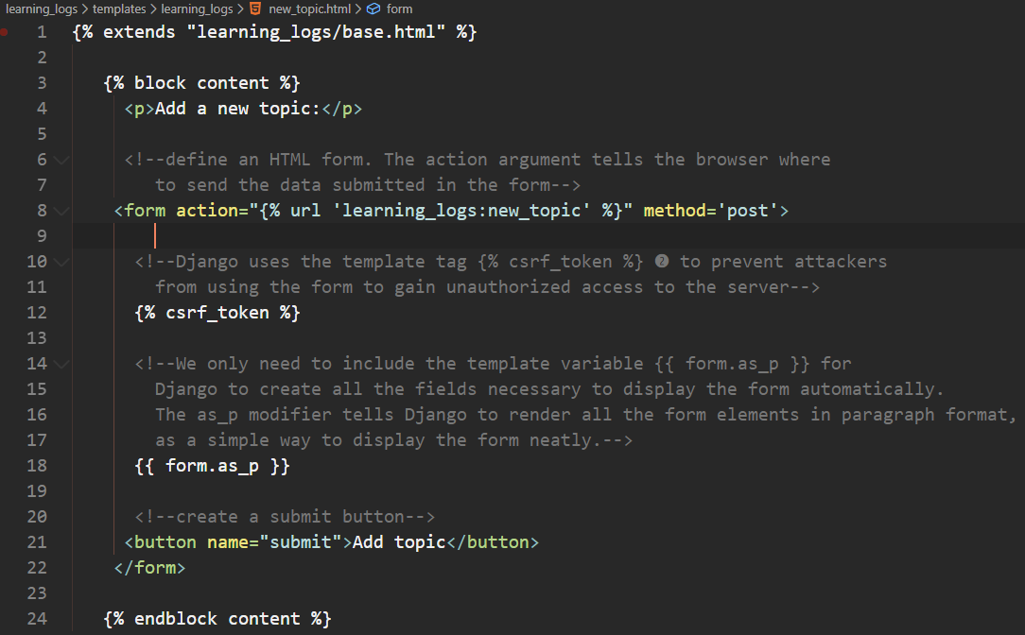
The new_topic Template

Slide 9
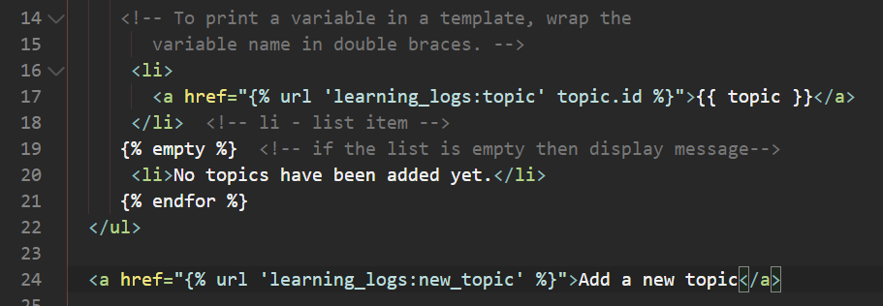
Linking to the new_topic Page
Create a link in the topic page (topics.html) so that users can add new topics of their own

Slide 10
Exercise – Allow users to make new entries
Create the form – forms.py
Define the URL – urls.py
Define the function – views.py
Define the template – new_entry.html
Add a link – Topics.html

